Slide 1
Algorithm
Assignment 3
물리학과 20182326 이선민

Slide 2
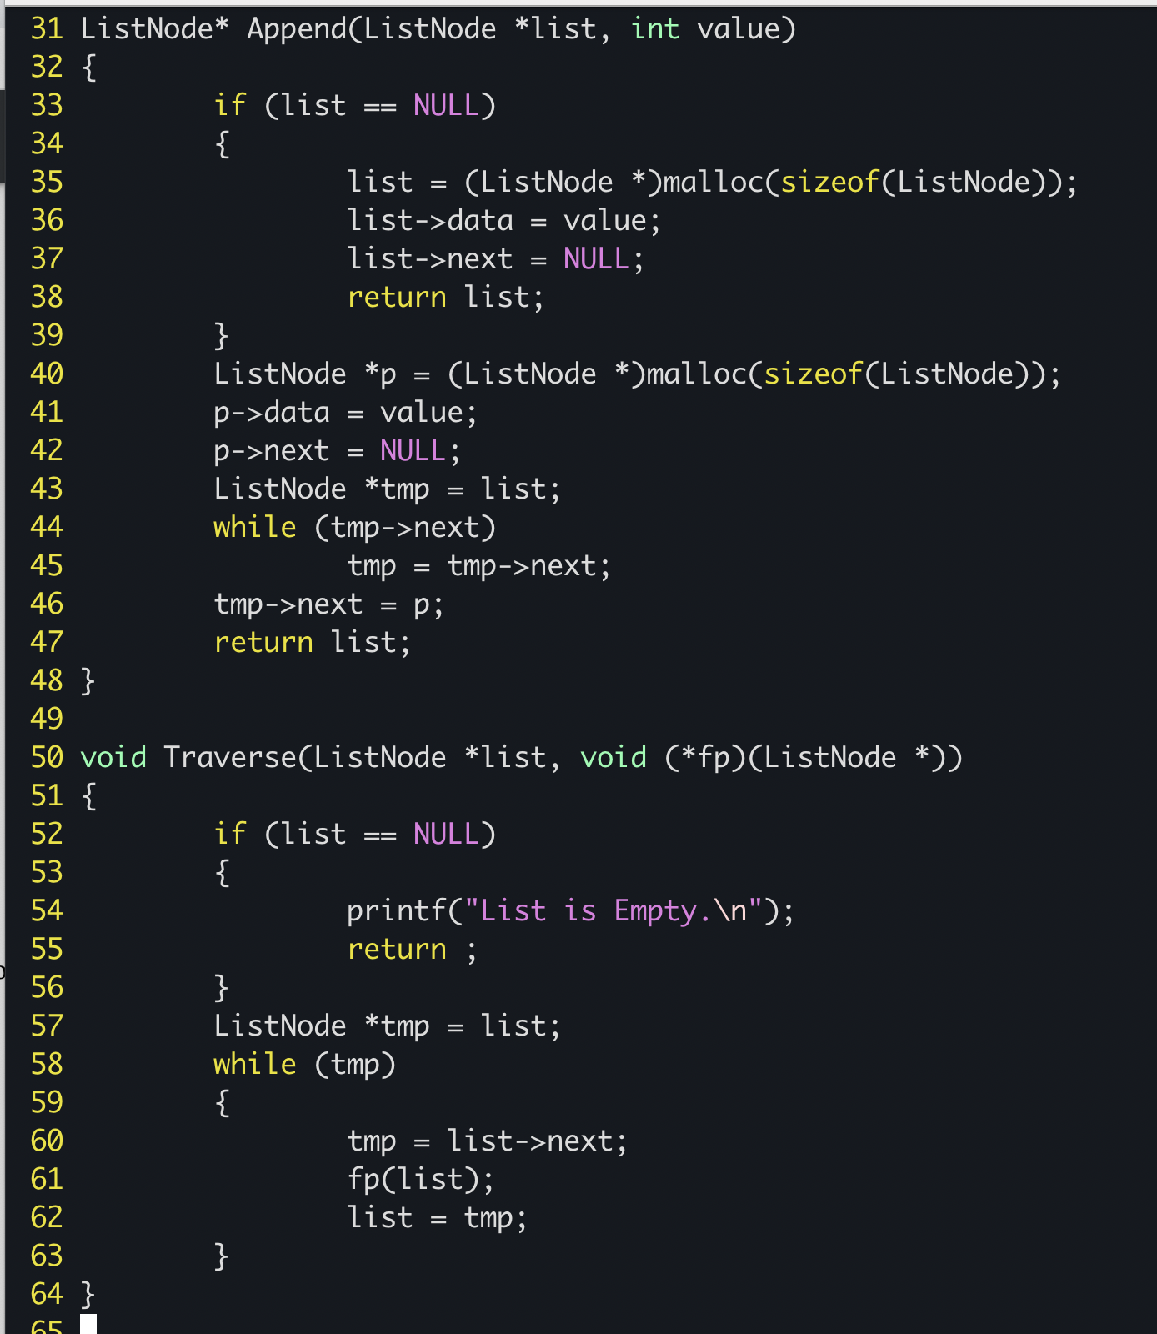
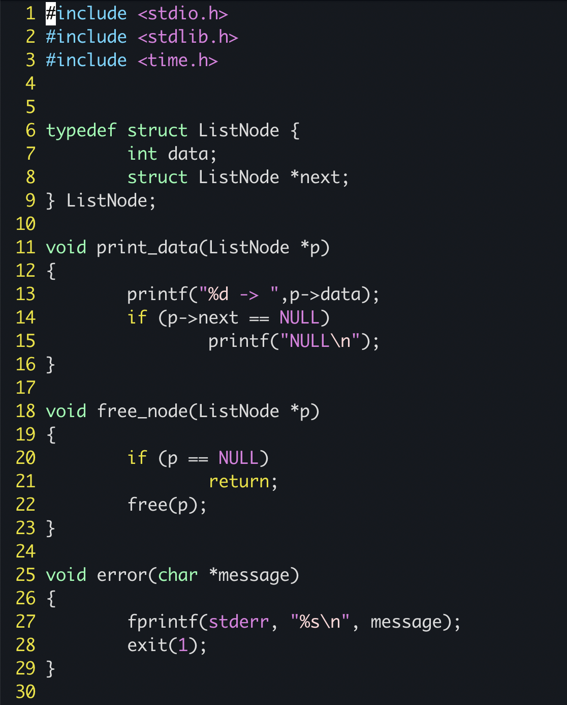
Problem 1 - code

Slide 3
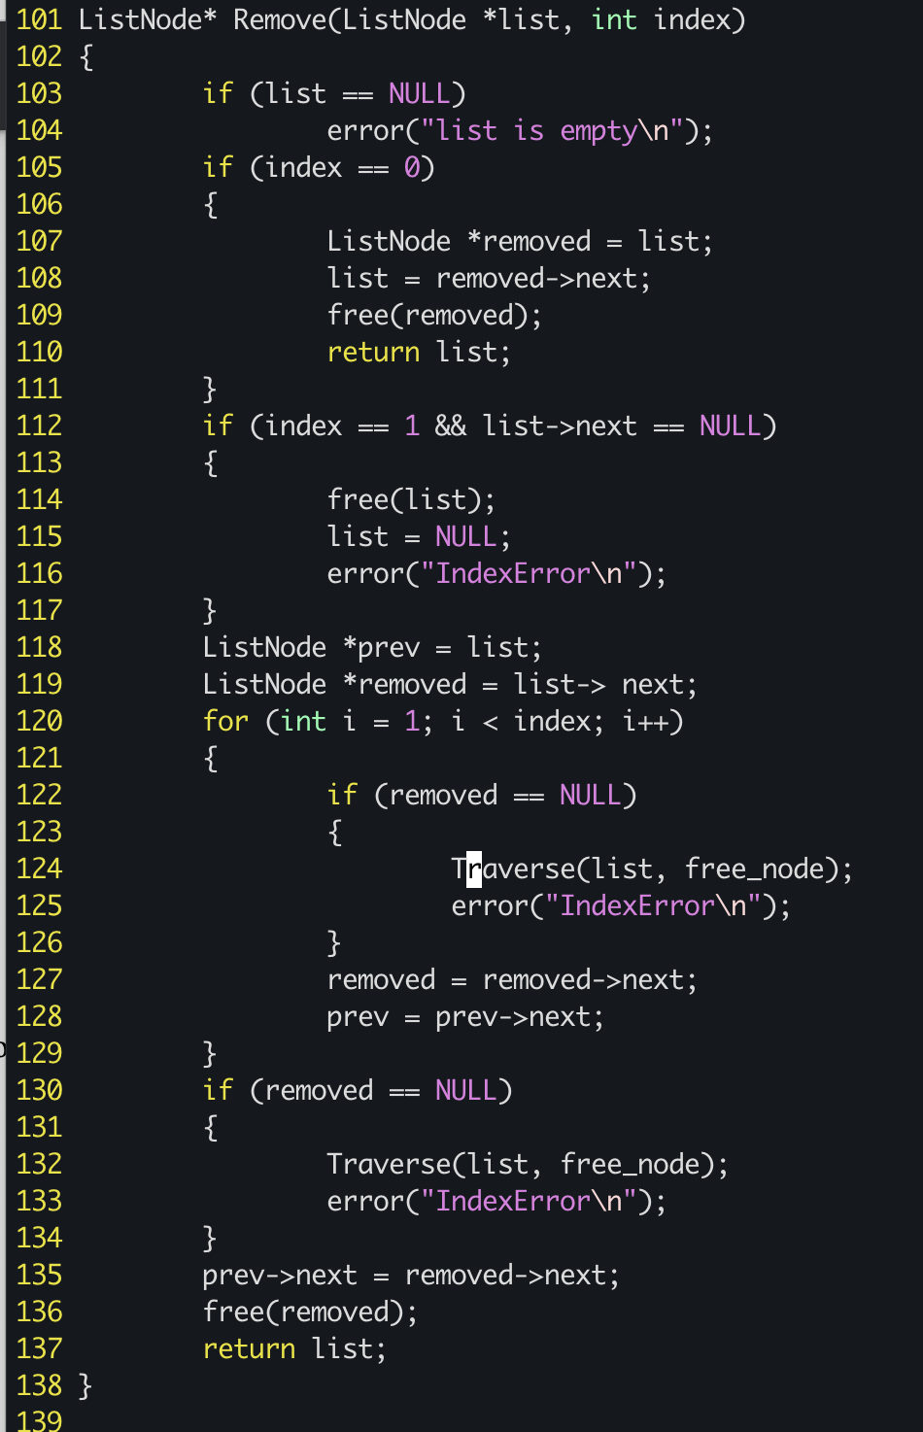
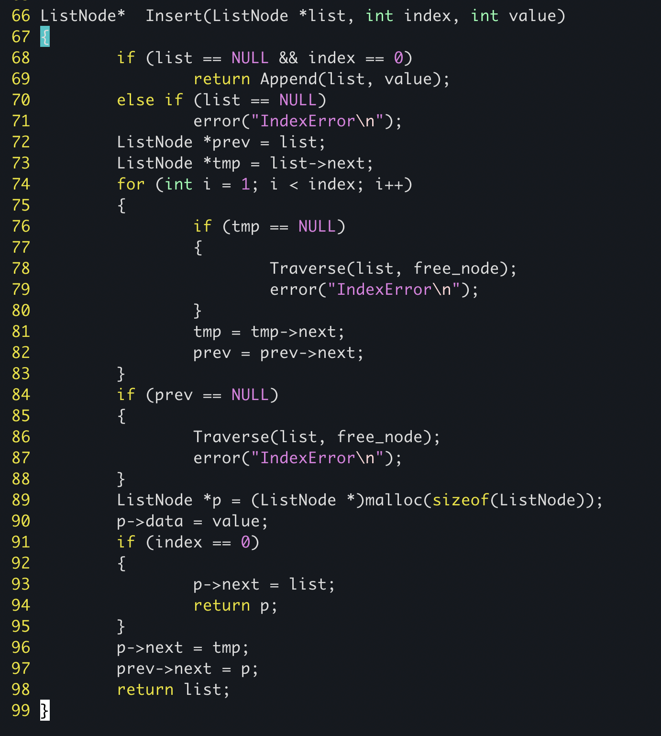
Problem1 - code

Slide 4
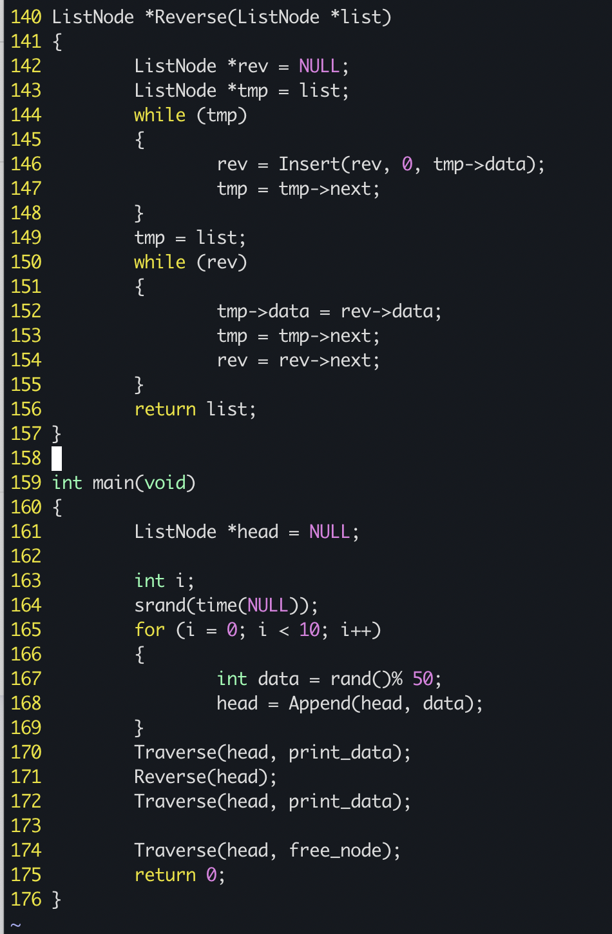
Problem1 - code

Slide 5
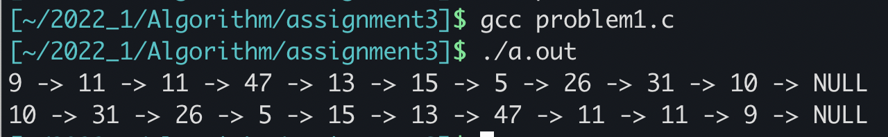
Problem 1 - result

Slide 6
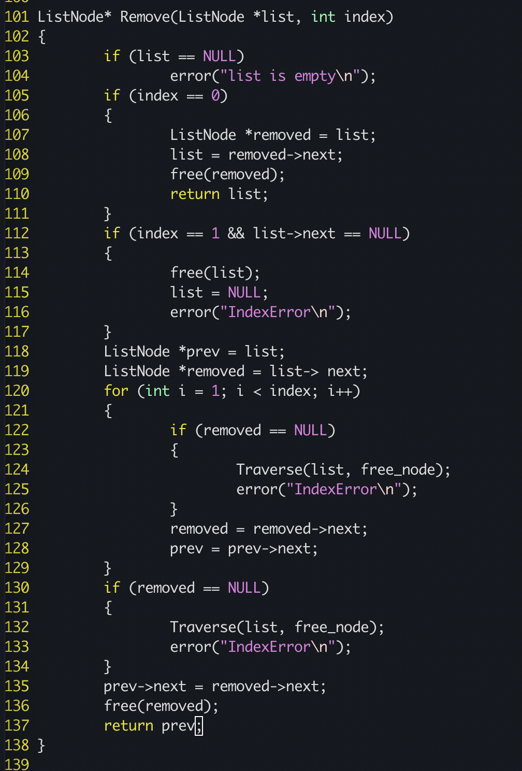
Problem2 - code
The linked list code was used in the same way as Problem 1, but only the return value of the Remove function was changed. The return value was set as the node immediately before the deleted node.

Slide 7
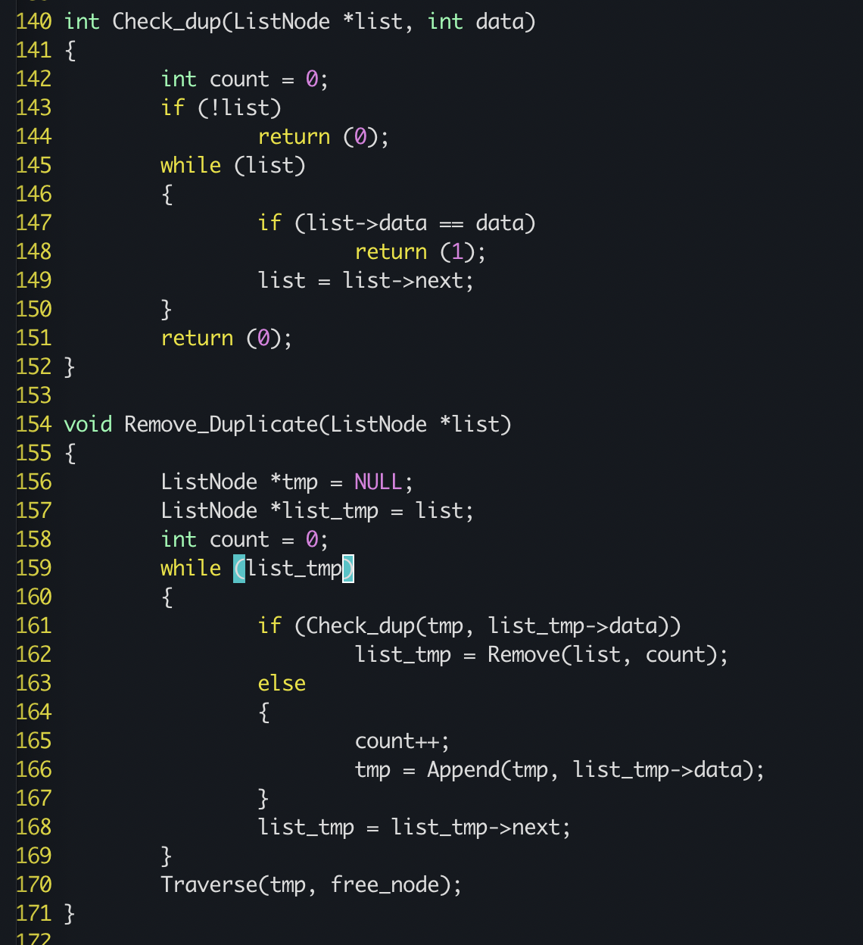
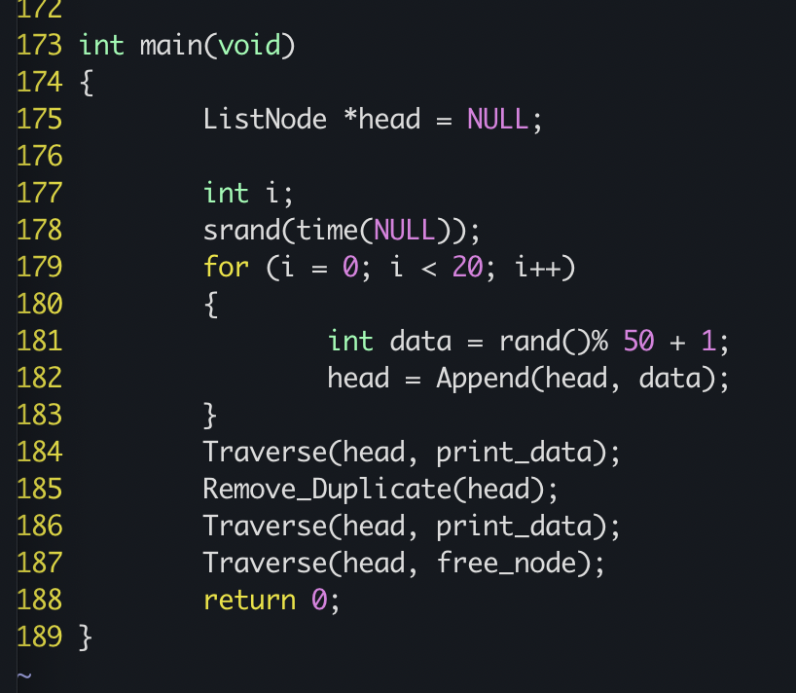
Problem2 - newly added function, modifying main function

Slide 8

Problem2 - result

Slide 9
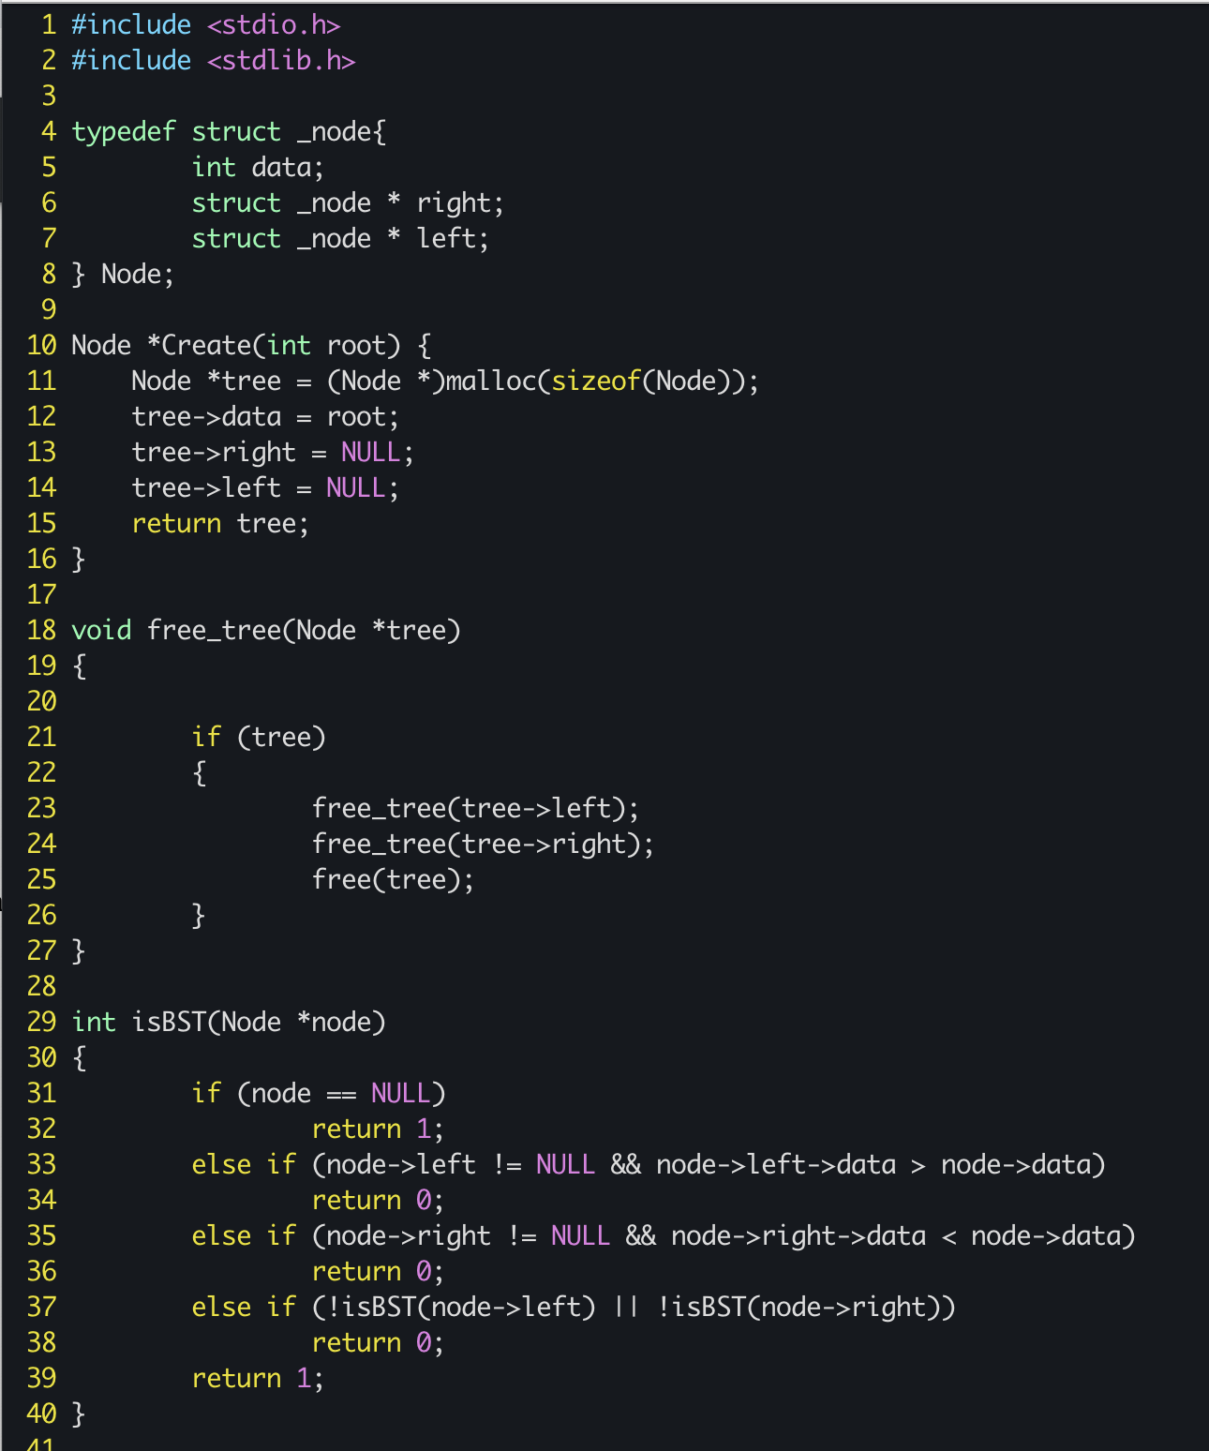
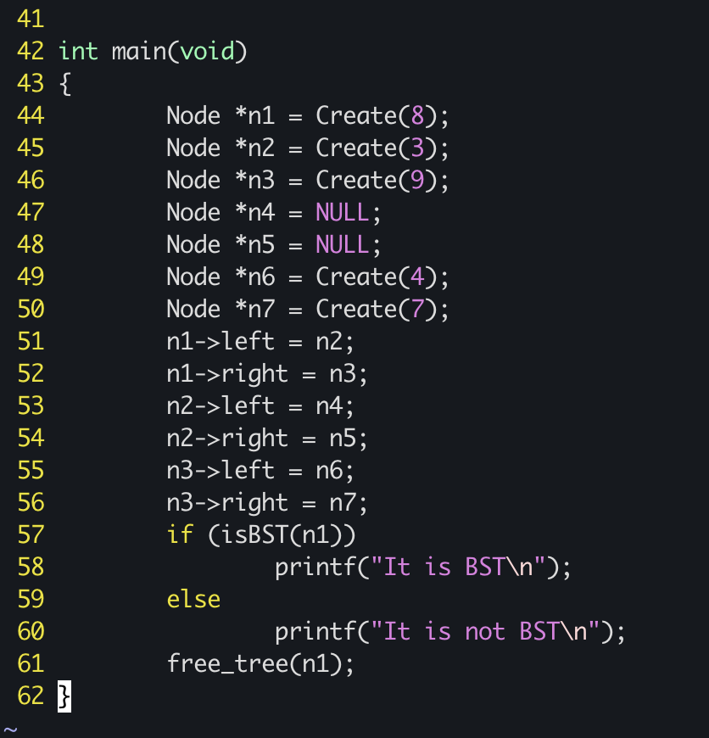
Problem3 - code

Slide 10
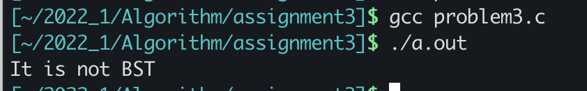
Problem3 - result

Slide 11
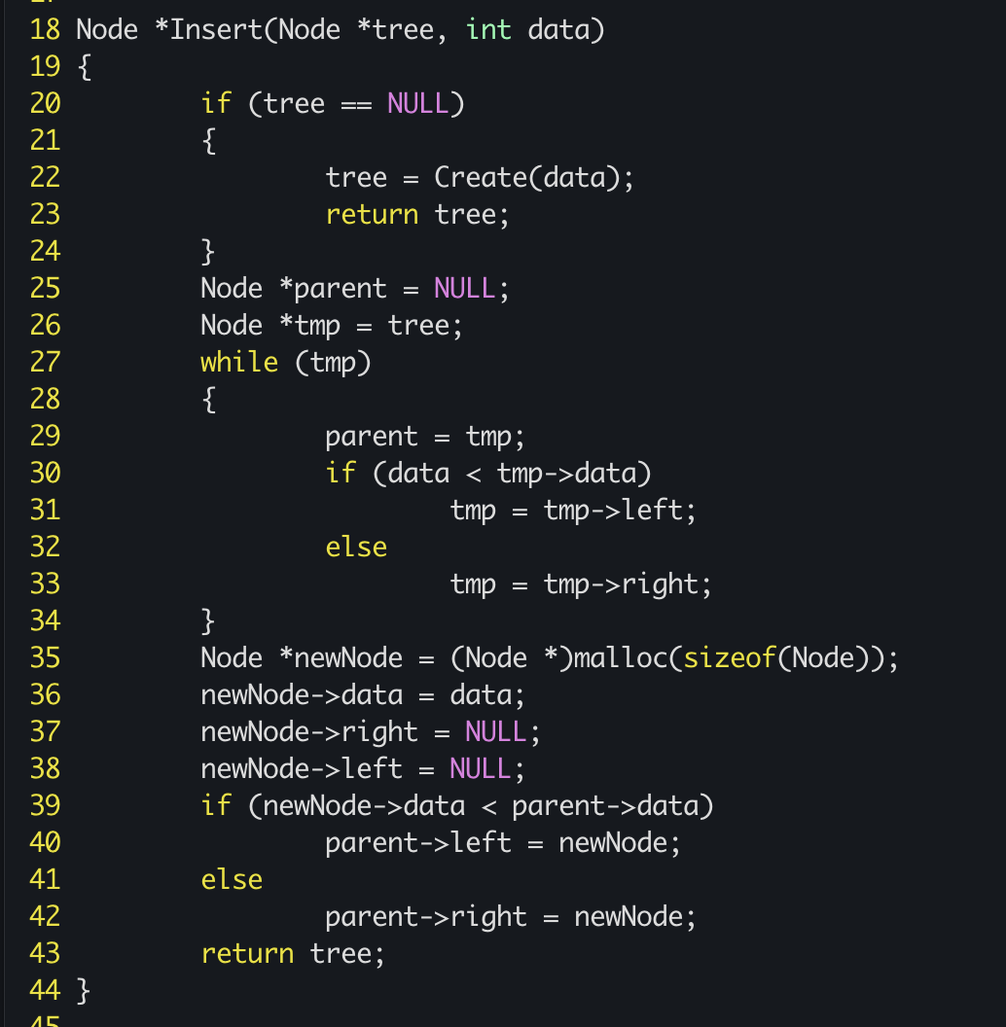
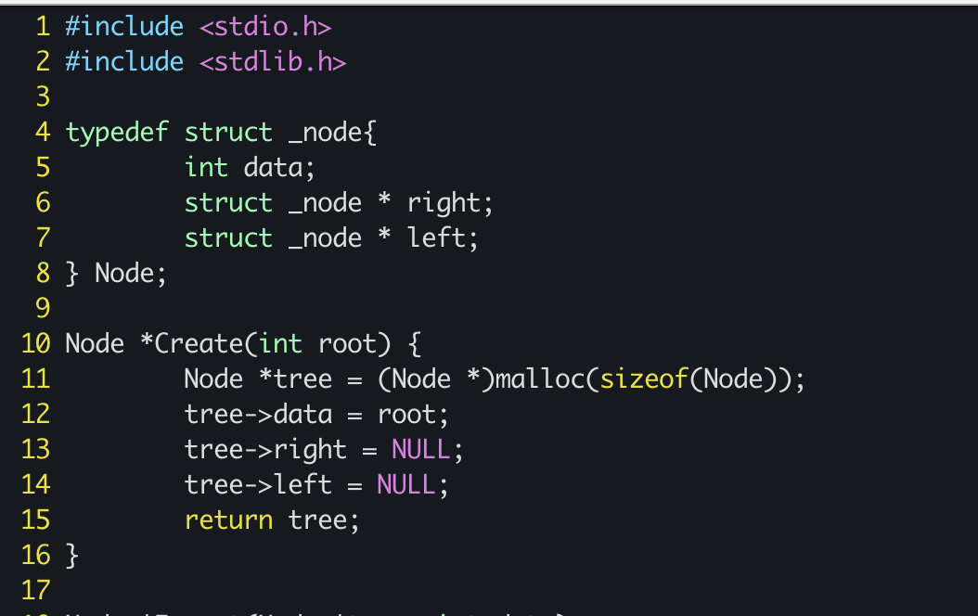
Problem4 - code

Slide 12
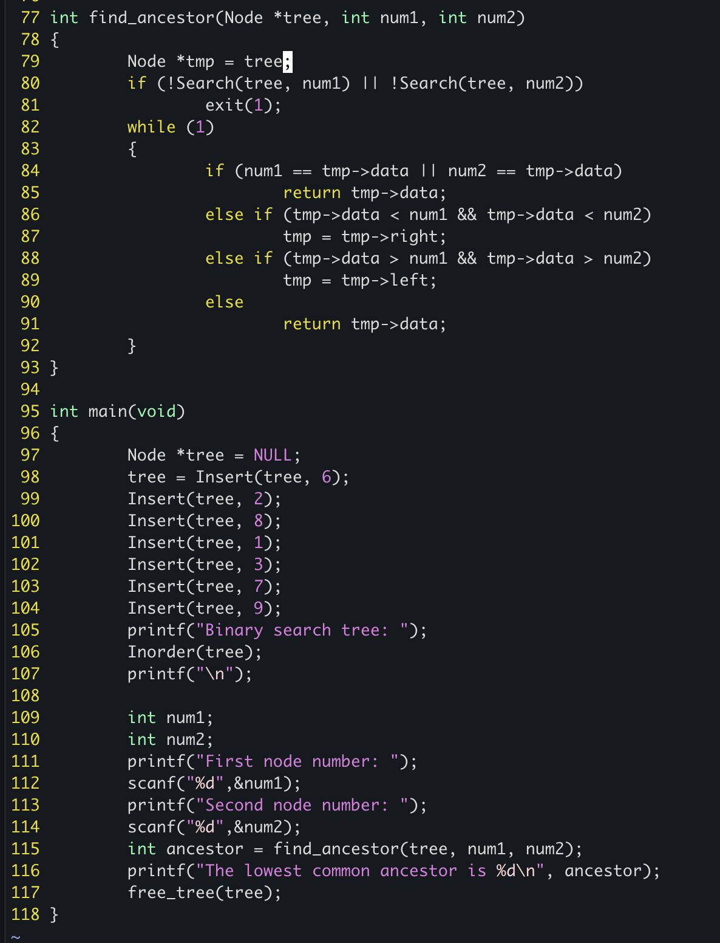
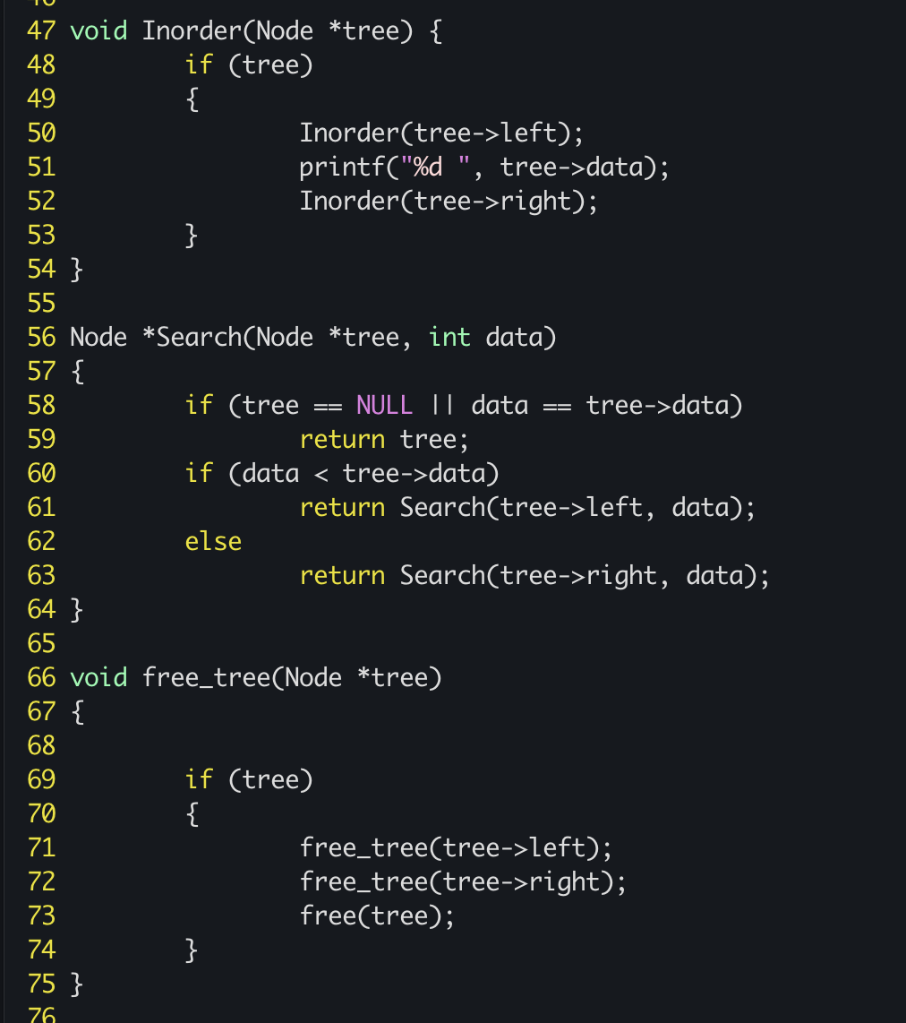
Problem4 - code

Slide 13
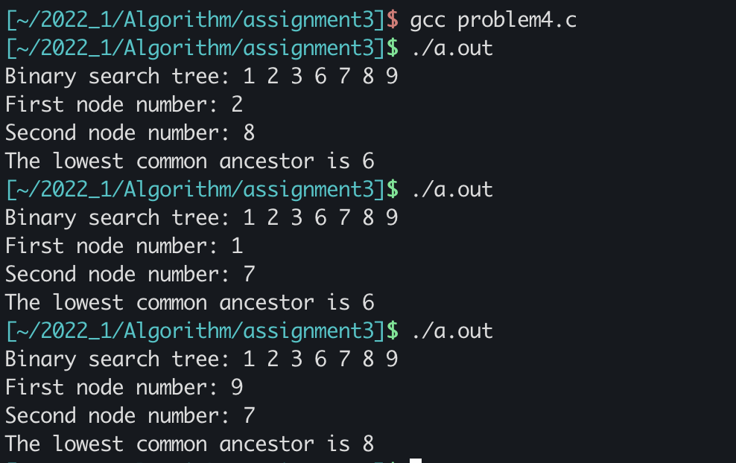
Problem4 - result

